Slide 1
Machine Learning and Generalization
Bradford Lynch
STAT991 – Deep Learning

Slide 2
Machine Learning and Generalization
Estimate a mapping f from observed variables X_{i} to an outcome Y_{i}
If prediction is our goal, hopefully this mapping is useful when X_{i+1} is observed
How can we know if f will be useful?
Or…
How well will f generalize to new data?
X
Y
f

Slide 3
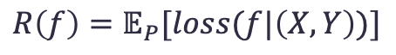
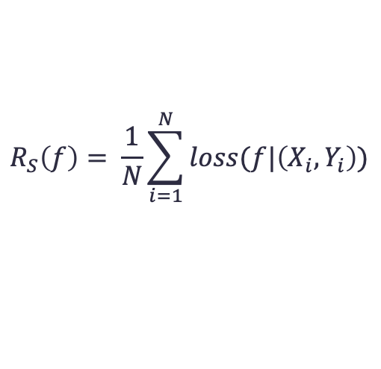
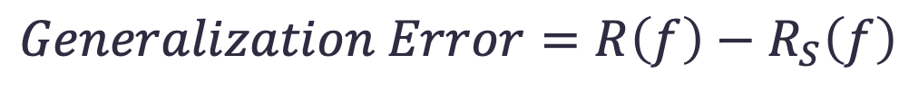
Generalization Error
Typically, f is estimated through empirical risk minimization:
Given a sample S of observations (Xi, Yi) i.i.d. from a distribution P, minimize the sample loss of f on S.
Ideally this generalization error is small but how can we know?
Population risk is unknown. Holdout set?
Minimize training loss:
Population risk:
$$R_{S}\left(f\right)= \frac{1}{N}\sum_{i=1}^{N}{loss(f|\left(X_{i},Y_{i}\right))}$$
$$R\left(f\right)=𝔼_{P}[loss(f|\left(X,Y\right))]$$
$$Generalization Error=R\left(f\right)−R_{S}\left(f\right)$$
$$Generalization Error≈R_{H}\left(f\right)−R_{S}\left(f\right)$$

Slide 4
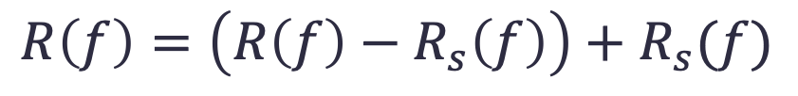
Fundamental “Theorem” of Machine Learning
$$R\left(f\right)=\left(R\left(f\right)−R_{s}\left(f\right)\right)+R_{s}(f)$$
Small training error implies that population risk equals the generalization error
Small or zero training error does not imply overfitting
Population Risk
Generalization Error
Training Error
Recht, 2019

Slide 5
Deep Neural Networks
These are highly overparameterized models, is it reasonable to expect that they won’t overfit the data? Do they have the capacity to memorize the data?
Under what conditions will they overfit?
Are larger models more likely to overfit the data?

Slide 6
Regularization
Regularization is meant to ensure that the generalization error is small
Explicit
Weight decay
Dropout
Data augmentation
Implicit
Early-stopping
Batch normalization

Slide 7
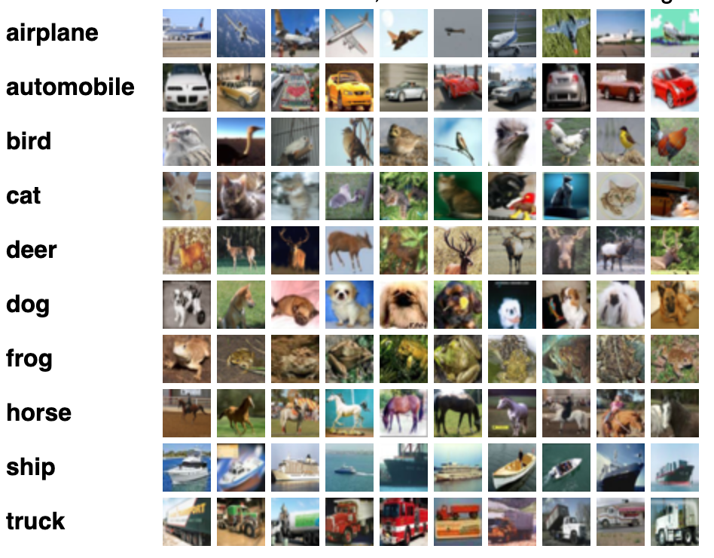
How Does Regularization Affect Test Error?
Approach:
Train a series of models on CIFAR10 but with regularization turned off
CIFAR10 (Krizhevsky & Hinton, 2009):
Image dataset with 10 classes and 50,000 training observations
Zhang, Bengio, Hardt, Recht, Vinyals, 2017

Slide 8
How Does Regularization Affect Test Error?
Approach:
Train a series of models on CIFAR10 but with regularization turned off
CIFAR10 (Krizhevsky & Hinton, 2009):
Image dataset with 10 classes and 50,000 training observations
Test error remains low, even without explicit regularization despite overparameterization
Model | Parameters | p/n | Train Loss | Test Error
CudaConvNet (W/Reg) | 145578 | 2.9 | 0.34 | 18%
CudaConvNet | 145578 | 2.9 | 0 | 23%
MicroInception | 1649402 | 33 | 0 | 14%
ResNet | 2401440 | 48 | 0 | 13%
Zhang, Bengio, Hardt, Recht, Vinyals, 2017

Slide 9
How Does Regularization Affect Test Error?
Approach:
Train a series of models on ImageNet but with regularization turned off
ImageNet (Russakovsky et al., 2015):
Image dataset with 1000 classes and n=1.3 million training observations
Test error again remains low without explicit regularization despite p > 20*n
Fake Data | L2 Reg/Dropout | Train Top-1 | Test Top-1 | Train Top-5 | Test Top-5
Yes | Yes | 13.70% | 23.40% | 2.50% | 6.50%
Yes | No | 8.20% | 27.10% | 1% | 9%
No | Yes | 0.60% | 29.80% | 0% | 11.20%
No | No | 0.50% | 39.70% | 0% | 19.30%
Szegedy, Vanhoucke, Ioffe, Shlens, Wojna, 2015

Slide 10
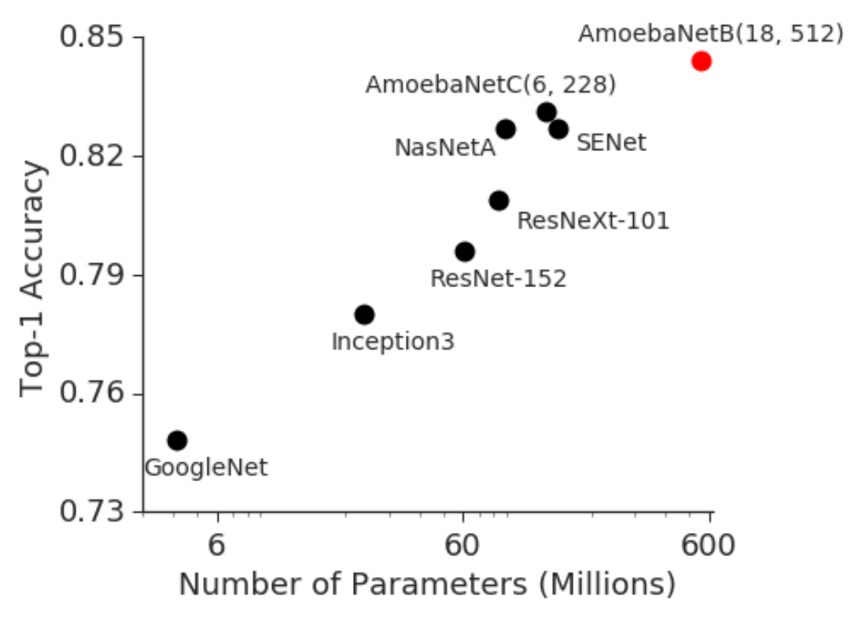
Overparameterization and Model Accuracy
Huang et al., 2019

Slide 11
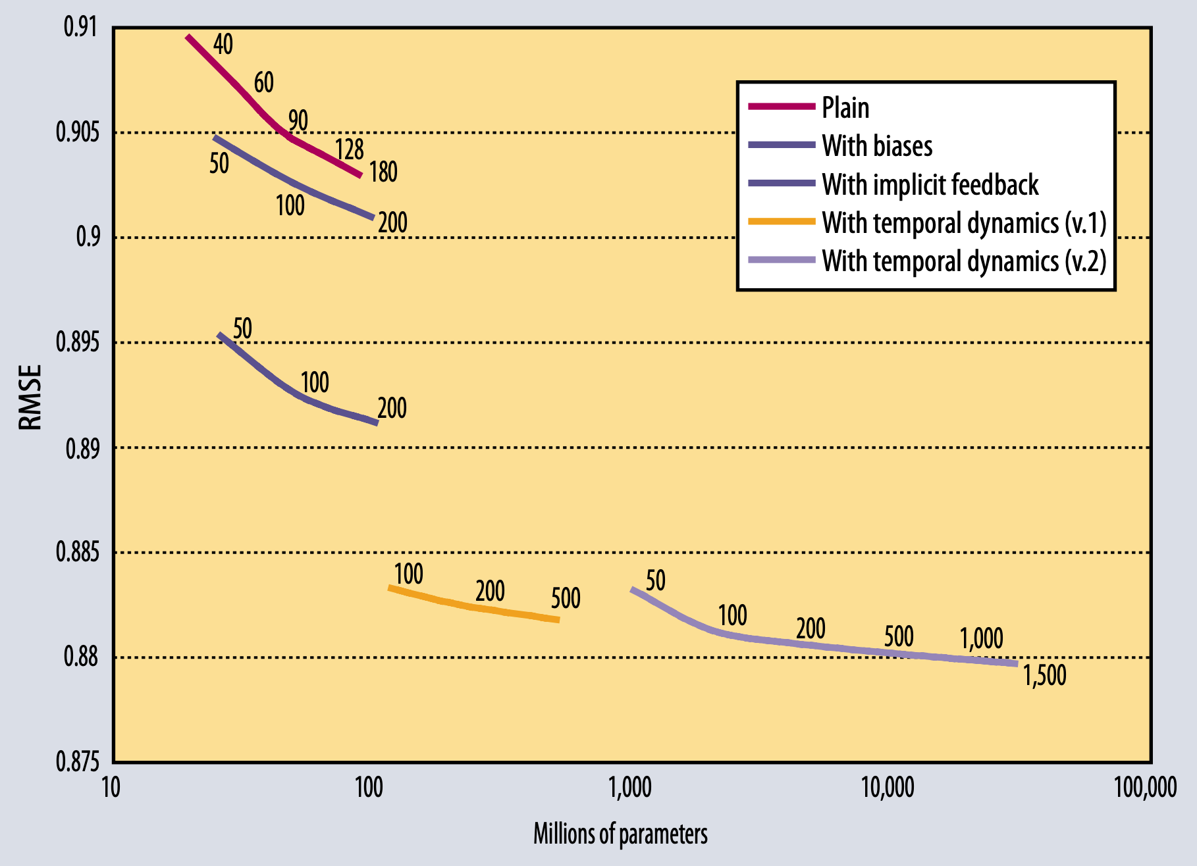
Overparameterization and Model Accuracy
Bell and Koren, 2009

Slide 12
Model Capacity and Memorization
Empirically, it would seem that despite overparameterization, deep models generalize well
If we keep increasing the number of parameters, do we get to the point where the model is just memorizing the data?
What is the effective capacity of these models?

Slide 13
Model Capacity and Memorization – Randomized Data
To investigate the capacity of deep models, we are going to corrupt the CIFAR10 dataset in various ways
True Labels – No changes
Partial Corruption – with prob p, randomly choose a new label
Random Labels – all labels are random
Shuffled Pixels – a random permutation of the pixels is chosen and applied to all images in the training and test sets
Random Pixels – a different random permutation is applied to each image
Gaussian – a G dist is used to generate random pixels for each image
Zhang, Bengio, Hardt, Recht, Vinyals, 2017

Slide 14
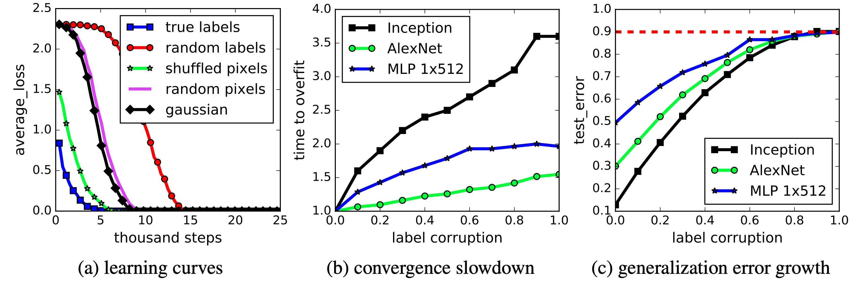
Model Capacity and Memorization – Randomized Data
Without any changes to model hyperparameters, SGD can fit the labels perfectly
Zhang, Bengio, Hardt, Recht, Vinyals, 2017

Slide 15
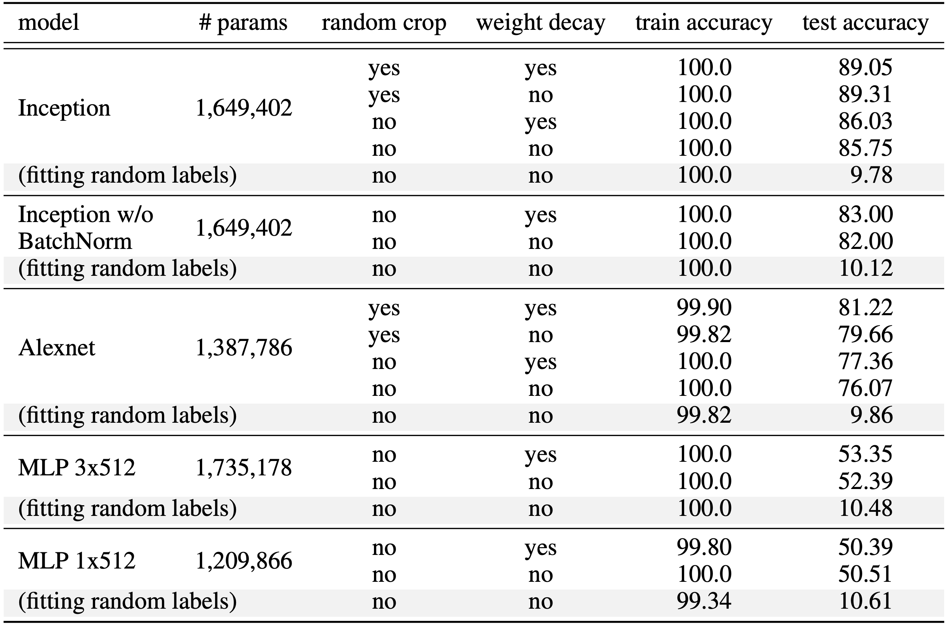
How Does Regularization Affect Test Error?
Empirically, data augmentation is a more effective regularizer than L2
Zhang, Bengio, Hardt, Recht, Vinyals, 2017

Slide 16
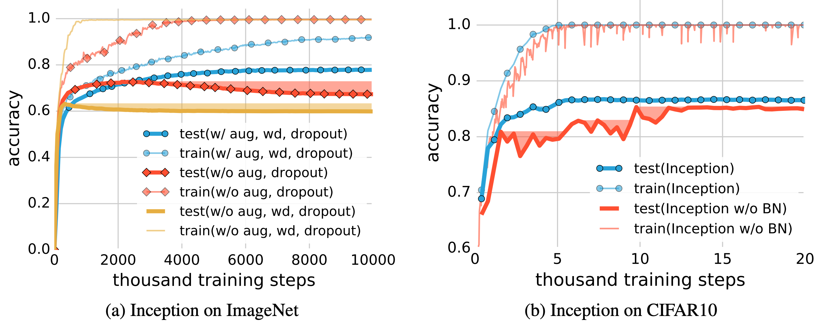
How Does Regularization Affect Test Error?
Batch-normalization has a marginal improvement on test error but appears to stabilize the training process
Zhang, Bengio, Hardt, Recht, Vinyals, 2017

Slide 17
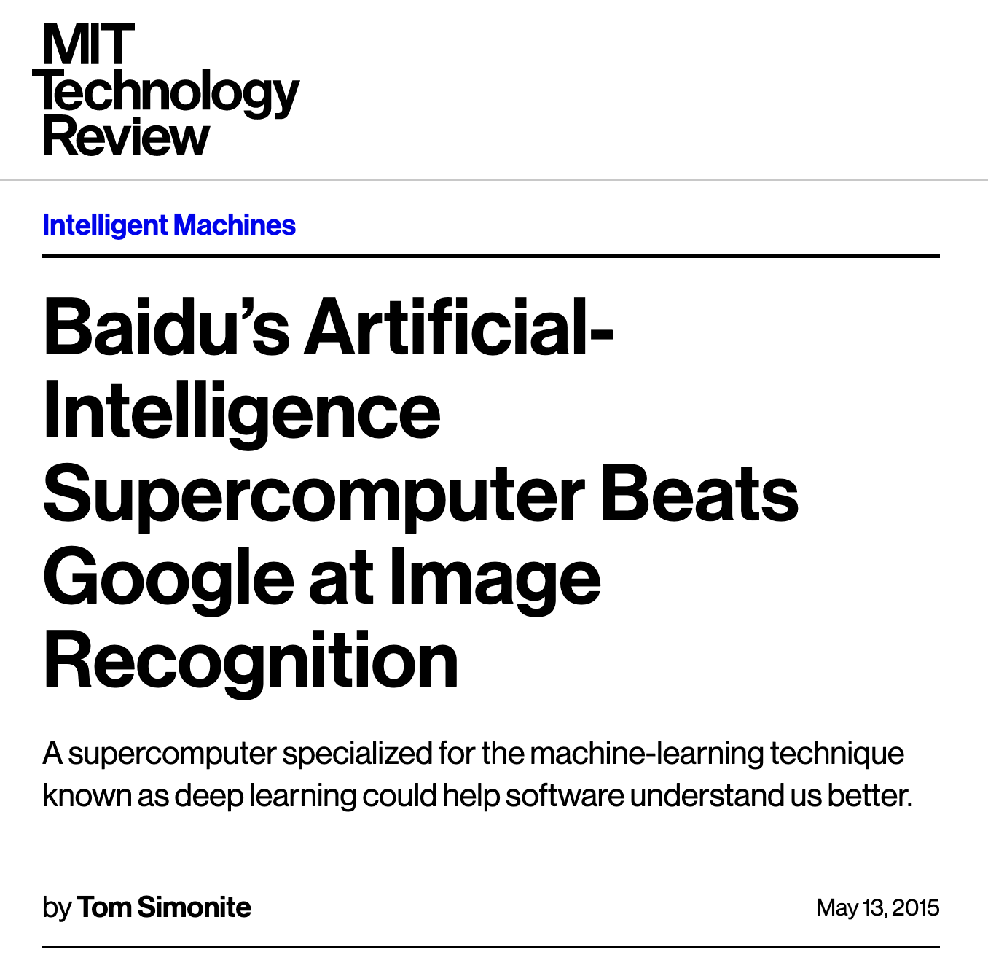
Training on the Test Set

Slide 18
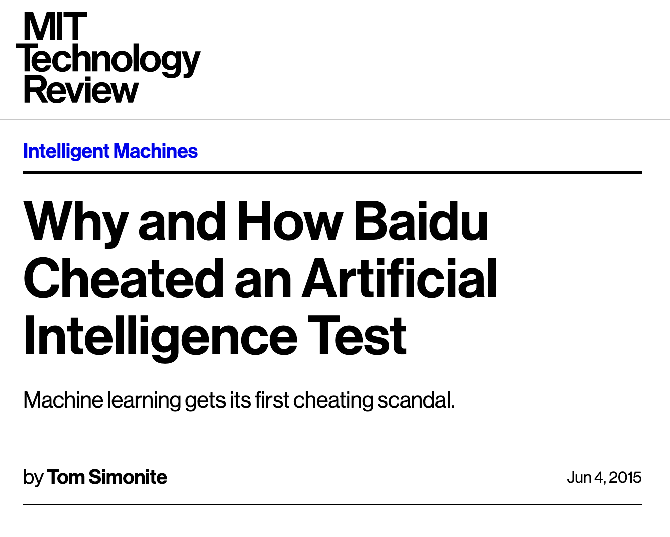
Training on the Test Set
Baidu used fake accounts to view the results of ~200 models on the test set

Slide 19
Training by GSD – Leakage of the Test Set
“Graduate Student Descent” is the idea that a researcher trains a model, looks at the test error, and updates their beliefs about what makes a “good” model architecture
Overtime, information from the test set bleeds into the training process

Slide 20
Training by GSD – Leakage of the Test Set
“Graduate Student Descent” is the idea that a researcher trains a model, looks at the test error, and updates their beliefs about what makes a “good” model architecture
Overtime, information from the test set bleeds into the training process
CIFAR10 SOTA
Year | Model | Test Accuracy
2009 | Raw pixels | 37.3%
2009 | RBM | 64.8%
2011 | Random features | 79.6%
2012 | AlexNet | 88.5%
2014 | VGG | 92.8%
2015 | ResNet | 93.5%
2016 | Wide ResNet | 95.9%
2017 | Shake Shake | 97.1%
Deep Models

Slide 21
Training by GSD – Leakage of the Test Set
“Graduate Student Descent” is the idea that a researcher trains a model, looks at the test error, and updates their beliefs about what makes a “good” model architecture
Overtime, information from the test set bleeds into the training process
CIFAR10 SOTA
Year | Model | Test Accuracy
2009 | Raw pixels | 37.3%
2009 | RBM | 64.8%
2011 | Random features | 79.6%
2012 | AlexNet | 88.5%
2014 | VGG | 92.8%
2015 | ResNet | 93.5%
2016 | Wide ResNet | 95.9%
2017 | Shake Shake | 97.1%
If this is about the limit of shallow models, is the rest of the improvement just overfitting?
Deep Models

Slide 22
A New Test Set
How well the advances in image classification performance from the past 5 years generalize?
To answer this question, Roelfs, Schmidt, Shankar, and Recht (2018) collect a new i.i.d. sample of CIFAR10 using the original sampling process (As closely as they can)
They then evaluate a suite of models on this new sample

Slide 23
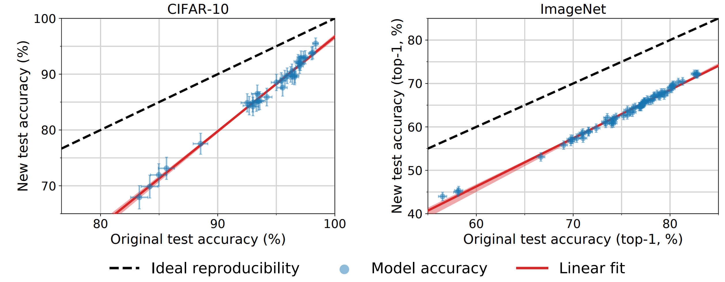
A New Test Set
Accuracy drops, but the ordering of models is preserved and improvements on the original test set translates to at least as much gain on the new test set
Roelfs, Schmidt, Shankar, Recht, 2019

Slide 24
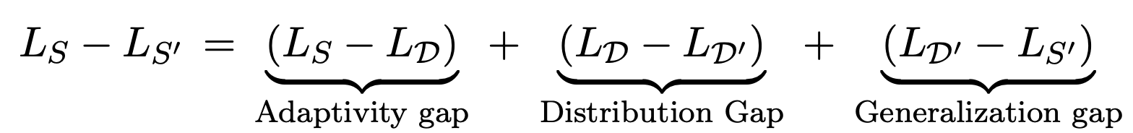
Causes of The Drop in Accuracy
Let S be the original sample from the underlying distribution D, S` be the resampling, and L be the loss of a model on a specific set of the data.
Decompose the loss between the original and new test sets as
Roelfs, Schmidt, Shankar, Recht, 2019

Slide 25
Causes of The Drop in Accuracy
Let S be the original sample from the underlying distribution D, S` be the resampling, and L be the loss of a model on a specific set of the data.
Decompose the loss between the original and new test sets as
Is the drop in accuracy solely due to generalization error?
Given the size of the new dataset, the 99.99% confidence interval for the out of sample accuracy is ±2%.
What if the resampling process systematically sampled harder observations?
Roelfs, Schmidt, Shankar, Recht, 2019

Slide 26
Causes of The Drop in Accuracy
Let S be the original sample from the underlying distribution D, S` be the resampling, and L be the loss of a model on a specific set of the data.
Decompose the loss between the original and new test sets as
Is the drop in accuracy due to adaptivity? E.g., training by GSD.
Hyperparameter tuning on the test set would contribute to the adaptivity gap, thus making the performance of the model dependent on the test set’s distribution.
Roelfs, Schmidt, Shankar, Recht, 2019

Slide 27
Causes of The Drop in Accuracy
Let S be the original sample from the underlying distribution D, S` be the resampling, and L be the loss of a model on a specific set of the data.
Decompose the loss between the original and new test sets as
Distribution gap?
The creation of CIFAR10 or ImageNet involves a complex process of sampling and labeling images. This was originally done using image search and MTurk nearly 10 years ago. It seems quite plausible that the distribution is different.
Roelfs, Schmidt, Shankar, Recht, 2019

Slide 28
